Slide 1

Transport Layer
All material copyright
J.F Kurose and K.W. Ross, All Rights Reserved

Slide 2
Transport Layer
our goals:
understand principles behind transport layer services:
multiplexing, demultiplexing
reliable data transfer
flow control
congestion control
learn about Internet transport layer protocols:
UDP: connectionless transport
TCP: connection-oriented reliable transport
TCP congestion control

Slide 3
Outline
3.1 transport-layer services
3.2 multiplexing and demultiplexing
3.3 connectionless transport: UDP
3.4 principles of reliable data transfer
3.5 connection-oriented transport: TCP
segment structure
reliable data transfer
connection management

Slide 4

















Transport services and protocols
application
transport
network
data link
physical
provide logical communication between app processes running on different hosts
transport protocols run in end systems
send side: breaks app messages into segments, passes to network layer
receiving side side: reassembles segments into messages, passes to app layer
more than one transport protocol available to apps
Internet: TCP and UDP
logical end-end transport
application
transport
network
data link
physical

Slide 5
Transport vs. network layer
network layer: logical communication between hosts
transport layer: logical communication between processes
relies on, enhances, network layer services
household analogy:
12 kids in Ann’s house sending letters to 12 kids in Bill’s house:
hosts = houses
processes = kids
app messages = letters in envelopes
transport protocol = Ann and Bill who demux to in-house siblings
network-layer protocol = postal service

Slide 6
Internet transport-layer protocols
reliable, in-order delivery (TCP)
congestion control
flow control
connection setup
unreliable, unordered delivery: UDP
no-frills extension of “best-effort” IP
services not available:
delay guarantees
bandwidth guarantees
application
transport
network
data link
physical
network
data link
physical
network
data link
physical
network
data link
physical
logical end-end transport
network
data link
physical
network
data link
physical
network
data link
physical
network
data link
physical
application
transport
network
data link
physical
Notes:
The only two services that UDP provides:
process-to-process data delivery
error checking
It does not guarantee that data sent by one process will arrive intact (or at all!) to the destination process.

Slide 7
Outline
3.1 transport-layer services
3.2 multiplexing and demultiplexing
3.3 connectionless transport: UDP
3.4 principles of reliable data transfer
3.5 connection-oriented transport: TCP
segment structure
reliable data transfer
connection management

Slide 8

Multiplexing/demultiplexing
multiplexing at sender:
demultiplexing at receiver:
handle data from multiple
sockets, add transport header (later used for demultiplexing)
use header info to deliver
received segments to correct
socket
application
application
P1
P2
application
socket
P3
transport
P4
process
transport
network
transport
network
link
network
link
physical
link
physical
physical
Notes:
Suppose you are sitting in front of your computer, and you are downloading Web pages while running one FTP session and two Telnet sessions.
You therefore have four network application processes running:
Two Telnet processes,
One FTP process
One HTTP process.
Important: a process can have one or more sockets. This will make the difference between UDP socket and TCP socket

Slide 9
How demultiplexing works
host receives IP datagrams
each datagram has source IP address, destination IP address
each datagram carries one transport-layer segment
each segment has source, destination port number
host uses IP addresses & port numbers to direct segment to appropriate socket
32 bits
source port #
dest port #
other header fields
application
data
(payload)
TCP/UDP segment format
Notes:
Each port number is a 16-bit number, ranging from 0 to 65535.
The port numbers ranging from 0 to 1023 are called well-known port numbers and are restricted (reserved for use by well-known application protocols):
HTTP port 80
FTP port 21
SMTP port 25

Slide 10
Connectionless demultiplexing
recall: created socket has host-local port #:
clientSocket = socket(AF_INET, SOCK_DGRAM)
clientSocket.bind((’’, 19157)) # to assign specific port
when host receives UDP segment:
checks destination port # in segment
directs UDP segment to socket with that port #
IP datagrams with same dest. port #, but different source IP addresses and/or source port numbers will be directed to same socket at dest

Slide 11
Connectionless demux: example
port(9157)
port(6428)
port(5775);
application
application
P1
application
P3
P4
transport
transport
network
transport
network
link
network
link
physical
link
physical
physical
source port: 6428
dest port: 9157
source port: ?
dest port: ?
source port: 9157
dest port: 6428
source port: ?
dest port: ?

Slide 12
Connection-oriented demux
TCP socket identified by 4-tuple:
source IP address
source port number
dest IP address
dest port number
demux: receiver uses all four values to direct segment to appropriate socket
server host may support many simultaneous TCP sockets:
each socket identified by its own 4-tuple
web servers have different sockets for each connecting client
non-persistent HTTP will have different socket for each request

Slide 13
Connection-oriented demux: example
application
application
P4
P5
P6
application
P3
P2
P3
transport
transport
network
transport
network
link
network
link
physical
link
physical
server: IP address B
physical
host: IP address A
source IP,port: B,80
dest IP,port: A,9157
host: IP address C
source IP,port: C,5775
dest IP,port: B,80
source IP,port: A,9157
dest IP, port: B,80
source IP,port: C,9157
dest IP,port: B,80
three segments, all destined to IP address: B,
dest port: 80 are demultiplexed to different sockets
Notes:
A web server creates a new process for each connection. Each of these processes has its own connection socket through which HTTP requests arrive and HTTP responses are sent.

Slide 14
Connection-oriented demux: example
threaded server
application
application
application
P4
P3
P3
P2
transport
transport
network
transport
network
link
network
link
physical
link
physical
server: IP address B
physical
host: IP address A
source IP,port: B,80
dest IP,port: A,9157
host: IP address C
source IP,port: C,5775
dest IP,port: B,80
source IP,port: A,9157
dest IP, port: B,80
source IP,port: C,9157
dest IP,port: B,80
Notes:
There is not always a one-to-one correspondence between connection sockets and processes. In fact, today’s high-performing Web servers often use only one process, and create a new thread with a new connection socket for each new client connection.

Slide 15
Outline
3.1 transport-layer services
3.2 multiplexing and demultiplexing
3.3 connectionless transport: UDP
3.4 principles of reliable data transfer
3.5 connection-oriented transport: TCP
segment structure
reliable data transfer
connection management

Slide 16
UDP: User Datagram Protocol [RFC 768]
“no frills,” “bare bones” Internet transport protocol
“best effort” service, UDP segments may be:
lost
delivered out-of-order to app
connectionless:
no handshaking between UDP sender, receiver
each UDP segment handled independently of others
UDP use:
streaming multimedia apps (loss tolerant, rate sensitive)
DNS
SNMP
reliable transfer over UDP:
add reliability at application layer
application-specific error recovery!
Notes:
With UDP there is no handshaking between sending and receiving transport-layer entities before sending a segment. For this reason, UDP is said to be connectionless

Slide 17
UDP: segment header
length, in bytes of UDP segment, including header
32 bits
source port #
dest port #
length
checksum
why is there a UDP?
no connection establishment (which can add delay)
simple: no connection state at sender, receiver
small header size
no congestion control: UDP can blast away as fast as desired
application
data
(payload)
UDP segment format
Notes:
the QUIC protocol (Quick UDP Internet Connection), used in Google’s Chrome browser, uses UDP as its underlying transport protocol and implements reliability in an application-layer protocol on top of UDP.

Slide 18
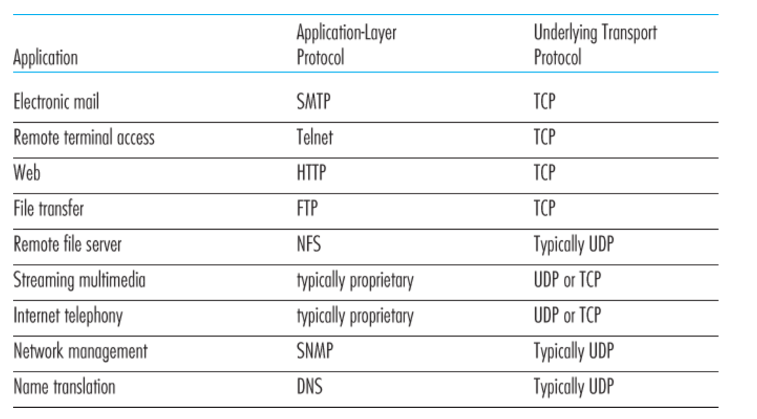
Applications and transport protocols

Slide 19
UDP checksum
Goal: detect “errors” (e.g., flipped bits) in transmitted segment
sender:
treat segment contents, including header fields, as sequence of 16-bit integers
checksum: addition (one’s complement sum) of segment contents
sender puts checksum value into UDP checksum field
receiver:
compute checksum of received segment
check if computed checksum equals checksum field value:
NO - error detected
YES - no error detected. But maybe errors nonetheless? More later ….

Slide 20
Internet checksum: example
example: add two 16-bit integers: E666 D555
1 1 1 1 0 0 1 1 0 0 1 1 0 0 1 1 0
1 1 1 0 1 0 1 0 1 0 1 0 1 0 1 0 1
1 1 0 1 1 1 0 1 1 1 0 1 1 1 0 1 1
1 1 0 1 1 1 0 1 1 1 0 1 1 1 1 0 0
1 0 1 0 0 0 1 0 0 0 1 0 0 0 0 1 1
wraparound
sum
checksum
Notes:
when adding numbers, a carryout from the most significant bit needs to be added to the result
At the receiver, all three 16-bit words are added, including the checksum. If no errors, then the sum at the receiver will be 1111111111111111
* Check out the online interactive exercises for more examples: http://gaia.cs.umass.edu/kurose_ross/interactive/
Notes:
At the receiver, all three 16-bit words are added, including the checksum. If no errors are introduced into the packet, then clearly the sum at the receiver will be 1111111111111111. If one of the bits is a 0, then we know that errors have been introduced into the packet.
Although UDP provides error checking, it does not do anything to recover from an error. Some implementations of UDP simply discard the damaged segment; others pass the damaged segment to the application with a warning.

Slide 21
Outline
3.1 transport-layer services
3.2 multiplexing and demultiplexing
3.3 connectionless transport: UDP
3.4 principles of reliable data transfer
3.5 connection-oriented transport: TCP
segment structure
reliable data transfer
connection management

Slide 22
Principles of reliable data transfer
One of the basic principles for reliable data transfer is flow control
Flow control is a technique for assuring that a transmitting entity does not overwhelm a receiving entity with data
The receiving entity typically allocates a data buffer of some maximum length for a transfer.
When data are received, the receiver must do a certain amount of processing before passing the data to the higher-level software
In the absence of flow control, the receiver’s buffer may fill up and overflow while it is processing old data

Slide 23
Stop-and-Wait Flow Control
The simplest form of flow control and it works as follows:
A source entity transmits a frame
After the destination entity receives the frame, it indicates its willingness to accept another frame by sending back an acknowledgment to the frame just received
The source must wait until it receives the acknowledgement before sending the next frame
The destination can thus stop the flow of data simply by withholding acknowledgment

Slide 24
Stop-and-Wait Flow Control
The procedure of stop-and-wait flow control works fine when a message is sent in a few large frames
However, it is often the case that a source will break up a large block of data into smaller blocks and transmit the data in many frames. This is done for the following reasons:
The buffer size of the receiver may be limited
The longer the transmission, the more likely that there will be an error, necessitating retransmission of the entire frame
On a shared medium, it is usually desirable NOT to permit one station to occupy the medium for an extended period.
With the use of multiple frames for a single message, the stop-and-wait procedure may be inadequate. The essence of the problem is that only one frame at a time can be in transit.

Slide 25
Sliding-Window Flow Control
It allows multiple frames to be in transit at the same time
Receiver has a buffer space for W frames
Transmitter can send up to W frames without acknowledgment (ACK)
Each frame is numbered
ACK includes number of next frame expected
ACK implicitly announces that the receiver is prepared to receive the next W frames, beginning with the number specified with the ACK

Slide 26
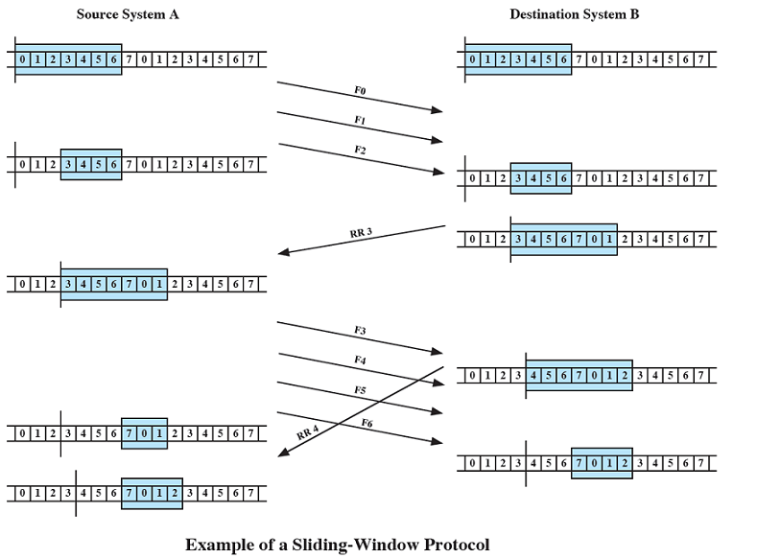
Sliding-Window Flow Control

Slide 27
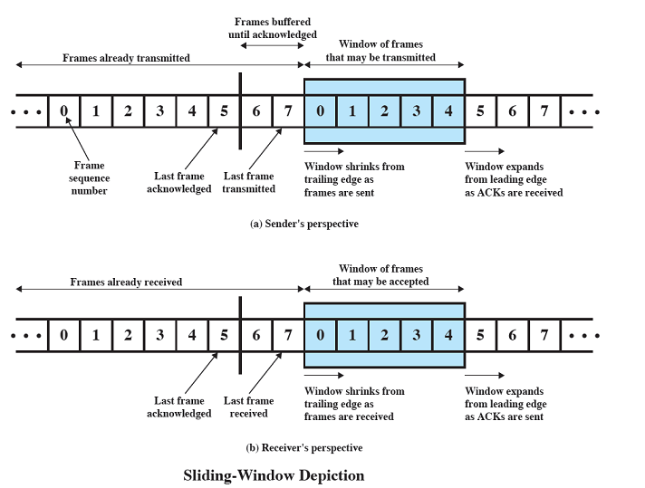
Sliding-Window Flow Control

Slide 28
Sliding-Window Flow Control
For example, a receiver could receive frames 2, 3, and 4 but withhold acknowledgement until frame 4 has arrived. By returning ACK with sequence number 5, the receiver is acknowledging frames 2,3, and 4. Also, it indicates that the receiver is ready to accept W frames beginning with frame number 5
The sender maintains a list of sequence numbers that is allowed to send, and the receiver maintains a list of sequence numbers that it is prepared to receive. Each of these lists can be thought of as a window of frames
Sequence number is bounded by size of field. For a k-bit, sequence number is 0 through 2^{k} – 1. Frames are numbered modulo 2^{k} . Example, for 3 bits, the sequence number ranges from 0 to 7.

Slide 29
Sliding-Window Flow Control
Each time a frame is sent, the shaded window shrinks (from the left side)
Each time an acknowledgement is received, the shaded window grows (to the right side)
Frames between the vertical bar and the shaded window have been sent but not yet acknowledged. The sender must buffer these frames in case they need to be retransmitted
The window size need NOT to be the maximum possible size (more on that later)

Slide 30
Sliding-Window Flow Control
Receiver can acknowledge frames without permitting further transmission (Receive Not Ready RNR)
Thus, RNR 5 means “I have received all frames up to number 4 but am unable to accept any more at this time”
Later, the receiver must send a normal acknowledgement to resume transmission

Slide 31
Sliding-Window Flow Control
If two stations exchange data (full-duplex), each needs to maintain two windows, one for transmit and one for receive. Also, each side needs to send the data and acknowledgements to the other.
For efficiency, a feature known as piggybacking if provided.
Each data frame includes a field that holds the sequence number of that frame plus a field that holds the sequence number used for acknowledgement.
One frame can be used to send both data and acknowledgment, saving communication capacity
If a station has an acknowledgment but no data, it sends a separate acknowledgment such as RR or RNR
If a station has data to send but no new acknowledgment, it must repeat the last acknowledgment sequence number that it sent

Slide 32
Sliding-Window Flow Control
Sliding-window flow control is potentially much more efficient than stop-and-wait flow control. With sliding-window flow control, the transmission link is treated as a pipeline that may be filled with frames in transit. With stop-and-wait flow control, only one frame may be in the pipe at a time
Assume 3-bit sequence number (0 to 7), and suppose a transmitter sends frame 0 and gets RR 1. Then, the transmitter sends frames 1, 2, 3, 4, 5, 6, 7, 0, and gets another RR 1. This could mean ALL 8 frames are received with no error or ALL of them are lost and the receiver is repeating the previous RR 1.
To avoid such situation, the maximum window size is limited to 7 (2³-1). In general the maximum window size is 2^{k}-1

Slide 33
Error Control
Error control is a basic principle for reliable data transfer
Error control refers to mechanisms to detect and correct errors in the transmission of frames.
Two types of errors
Lost frame. A frame fails to arrive at the other side
Damaged frame. A frame does arrive, but some of bits are in error

Slide 34
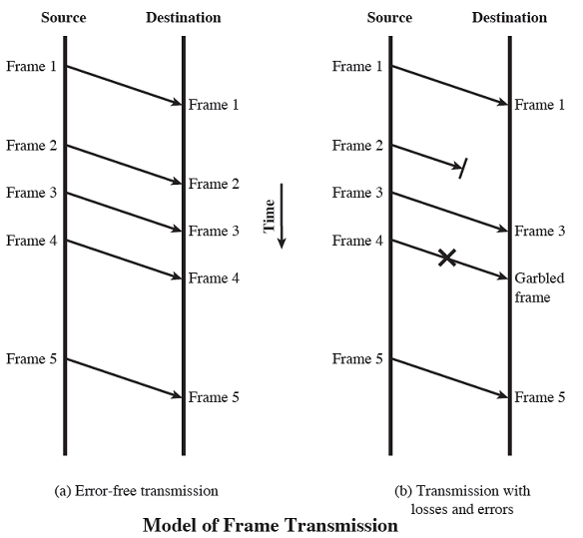
Error Control

Slide 35
Error Control
The most common techniques for error controls are based on some or all of the following ingredients:
Error detection. Ignore frame with error
Positive acknowledgement. ACK for receiving error-free frame
Retransmission after timeout. No ACK within predetermined time, so retransmit
Negative acknowledgment and retransmission. ACK for detecting errors in a frame, and source retransmits such a frame

Slide 36
Error Control
Automatic Repeat Request (ARQ)
Collective name for error control mechanisms
Effect of ARQ is to turn an unreliable data link into a reliable one
Three versions of ARQ have been standardized
Stop-and-wait ARQ
Go-back-N ARQ
Selective-reject ARQ

Slide 37
Stop-and-wait ARQ
Source transmits single frame
Waits for ACK
No other data can be sent until destination’s reply arrives
If frame received is damaged, discard it
Transmitter has timeout
If no ACK within timeout, retransmit
If ACK is damaged, transmitter will not recognize
Transmitter will retransmit
Receiver gets two copies of frame
Use alternate numbering and ACK0 /ACK1

Slide 38
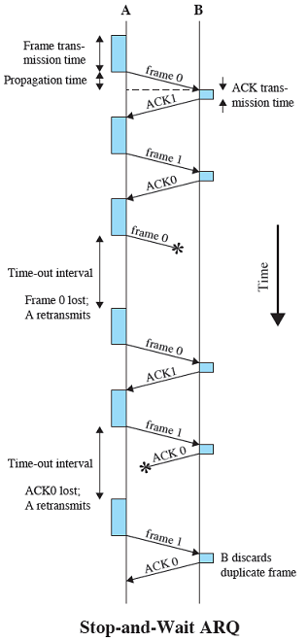
Stop-and-wait ARQ
The principal advantage of stop-and-wait ARQ is its simplicity
The principal disadvantage, it is inefficient mechanism

Slide 39
Go-Back-N ARQ
Most commonly used error control (why?)
Based on sliding-window flow control
Use window size to control number of outstanding frames
While no errors occur, the destination will acknowledge incoming frames as usual
RR = Receive Ready, or piggybacked acknowledgment
If the destination detects an error in a frame, it may send a negative acknowledgment
REJ = Reject
Destination will discard that frame and all future frames until the frame in error is received correctly
Transmitter must go back and retransmit that frame and all subsequent frames

Slide 40
Go-Back-N ARQ
Case 1: Damaged Frame
Receiver detects error in frame i
Receiver sends REJ-i
Transmitter retransmits frame i and all subsequent frames
Case 2: Lost Frame
Frame i is lost
Transmitter sends i + 1
Receiver gets frame i + 1 out of sequence
Receiver sends reject i
Transmitter goes back to frame i and retransmits

Slide 41
Go-Back-N ARQ
Case 3: Lost Frame: Frame i is lost and no additional frame sent
Receiver gets nothing and returns neither acknowledgement nor rejection
Transmitter times out and sends acknowledgement frame with P bit set to 1
Receiver interprets this as a command which it acknowledges with the number of the next frame it expects (frame i )
Transmitter then retransmits frame i

Slide 42
Go-Back-N ARQ
Case 4: Damaged Acknowledgement RR
Receiver gets frame i and send acknowledgement (i+1) which is lost
Acknowledgements are cumulative, so next acknowledgement (i + n) may arrive before transmitter times out on frame i
If transmitter times out, it sends acknowledgement with P bit set as before
This can be repeated a number of times before a reset procedure is initiated
Case 5: Damaged Rejection REJ. As for Frame i is lost and no additional frame sent

Slide 43
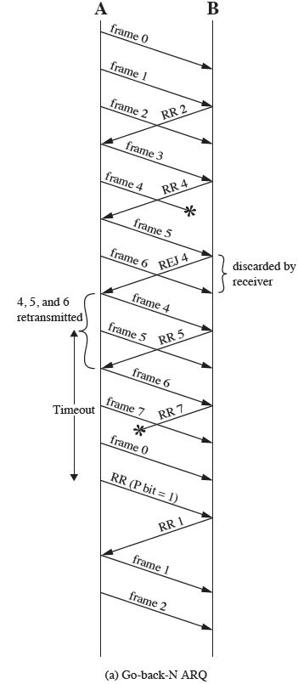
Go-Back-N ARQ

Slide 44
Selective-Reject ARQ
Only rejected frames are retransmitted (frames that receive SREJ)
Subsequent frames are accepted by the receiver and buffered
Minimizes retransmission
Receiver must maintain large enough buffer
Receiver must contain logic for inserting frames in proper sequence
Transmitter requires more complex logic to be able to send a frame out of sequence

Slide 45
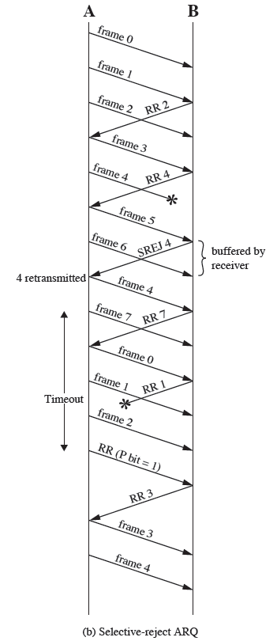
Selective-Reject ARQ

Slide 46
Outline
3.1 transport-layer services
3.2 multiplexing and demultiplexing
3.3 connectionless transport: UDP
3.4 principles of reliable data transfer
3.5 connection-oriented transport: TCP
segment structure
reliable data transfer
connection management

Slide 47
TCP: Overview RFCs: 793,1122,1323, 2018, 2581
point-to-point:
one sender, one receiver
reliable, in-order byte stream:
no “message boundaries”
pipelined:
TCP congestion and flow control set window size
full duplex data:
bi-directional data flow in same connection
MSS: maximum segment size
connection-oriented:
handshaking (exchange of control msgs) inits sender, receiver state before data exchange
flow controlled:
sender will not overwhelm receiver
Notes:
TCP is said to be connection-oriented because before one application process can begin to send data to another, the two processes must first “handshake” with each other

Slide 48
TCP segment structure
32 bits
URG: urgent data
(generally not used)
counting
by bytes
of data
(not segments!)
source port #
dest port #
sequence number
ACK: ACK #
valid
acknowledgement number
head
len
not
used
U
receive window
A
PSH: push data now
(generally not used)
P
R
S
F
# bytes
rcvr willing
to accept
checksum
Urg data pointer
RST, SYN, FIN:
connection estab
(setup, teardown
commands)
options (variable length)
application
data
(variable length)
Internet
checksum
(as in UDP)

Slide 49
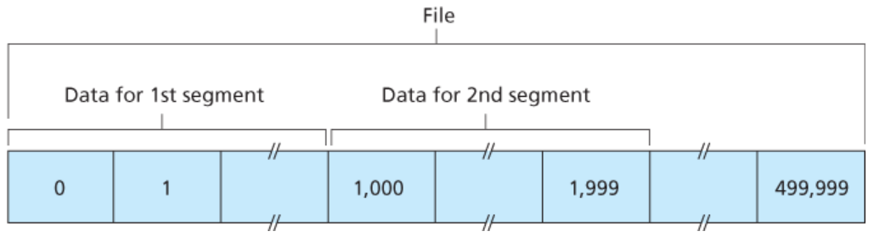
TCP seq. numbers, ACKs
sequence numbers:
byte stream “number” of first byte in segment’s data
acknowledgements:
seq # of next byte expected from other side
cumulative ACK
Q: how receiver handles out-of-order segments
A: TCP spec doesn’t say, - up to implementer
e.g., of size 500,000 bytes
Notes:
Suppose that the data stream consists of a file consisting of 500,000 bytes, segment size is 1,000 bytes, and that the first byte of the data stream is numbered 0.
Then, TCP constructs 500 segments out of the data stream. The first segment gets assigned sequence number 0, the second segment gets assigned sequence number 1,000, the third segment gets assigned sequence number 2,000, and so on
The acknowledgment number that Host A puts in its segment is the sequence number of the next byte Host A is expecting from Host B.
Suppose that Host A has received all bytes numbered 0 through 535 from B and suppose that it is about to send a segment to Host B. Host A is waiting for byte 536 and all the subsequent bytes in Host B’s data stream. So Host A puts 536 in the acknowledgment number field of the segment it sends to B.

Slide 50
TCP seq. numbers, ACKs
Host A
Host B
User
types
‘C’
Seq=42, ACK=79, data = ‘C’
host ACKs
receipt of
‘C’, echoes
back ‘C’
Seq=79, ACK=43, data = ‘C’
host ACKs
receipt
of echoed
‘C’
Seq=43, ACK=80
simple telnet scenario
Notes:
Telnet is a popular application-layer protocol used for remote login
Each character typed by the user (at the client) will be sent to the remote host; the remote host will send back a copy of each character, which will be displayed on the Telnet user’s screen. This “echo back” is used to ensure that characters seen by the Telnet user have already been received and processed at the remote site.
Now suppose the user types a single letter, ‘C,’ and then grabs a coffee.
Suppose the starting sequence numbers are 42 and 79 for the client and server, respectively.

Slide 51
Outline
3.1 transport-layer services
3.2 multiplexing and demultiplexing
3.3 connectionless transport: UDP
3.4 principles of reliable data transfer
3.5 connection-oriented transport: TCP
segment structure
reliable data transfer
connection management

Slide 52
TCP: retransmission scenarios
Host A
Host B
Host A
Host B
SendBase=92
Seq=92, 8 bytes of data
Seq=92, 8 bytes of data
timeout
timeout
Seq=100, 20 bytes of data
ACK=100
X
ACK=100
ACK=120
Seq=92, 8 bytes of data
Seq=92, 8
bytes of data
SendBase=100
SendBase=120
ACK=100
ACK=120
SendBase=120
lost ACK scenario
premature timeout

Slide 53
TCP: retransmission scenarios
Host A
Host B
Seq=92, 8 bytes of data
Seq=100, 20 bytes of data
timeout
ACK=100
X
ACK=120
Seq=120, 15 bytes of data
cumulative ACK

Slide 54
TCP fast retransmit
time-out period often relatively long:
long delay before resending lost packet
detect lost segments via duplicate ACKs.
sender often sends many segments back-to-back
if segment is lost, there will likely be many duplicate ACKs.
TCP fast retransmit
if sender receives 3 ACKs for same data
(“triple duplicate ACKs”), resend unacked segment with smallest seq #
likely that unacked segment lost, so don’t wait for timeout
(“triple duplicate ACKs”),
Notes:
One of the problems with timeout-triggered retransmissions is that the timeout period can be relatively long. When a segment is lost, this long timeout period forces the sender to delay resending the lost packet, thereby increasing the end-to-end delay.
Fortunately, the sender can often detect packet loss well before the timeout event occurs by noting so-called duplicate ACKs.

Slide 55
TCP fast retransmit
Host A
Host B
Seq=92, 8 bytes of data
Seq=100, 20 bytes of data
X
ACK=100
timeout
ACK=100
ACK=100
ACK=100
Seq=100, 20 bytes of data
fast retransmit after sender
receipt of triple duplicate ACK

Slide 56
Outline
3.1 transport-layer services
3.2 multiplexing and demultiplexing
3.3 connectionless transport: UDP
3.4 principles of reliable data transfer
3.5 connection-oriented transport: TCP
segment structure
reliable data transfer
connection management

Slide 57
Connection Management
before exchanging data, sender/receiver “handshake”:
agree to establish connection (each knowing the other willing to establish connection)
agree on connection parameters
application
application
connection state: ESTAB
connection variables:
seq # client-to-server
server-to-client
rcvBuffer size
at server,client
connection state: ESTAB
connection Variables:
seq # client-to-server
server-to-client
rcvBuffer size
at server,client
network
network
Socket clientSocket =
newSocket("hostname","port number");
Socket connectionSocket = welcomeSocket.accept();

Slide 58
TCP 3-way handshake
choose init seq num, x
send TCP SYN msg
SYNbit=1, Seq=x
choose init seq num, y
send TCP SYNACK
msg, acking SYN
SYNbit=1, Seq=y
ACKbit=1; ACKnum=x+1
received SYNACK(x)
indicates server is live;
send ACK for SYNACK;
this segment may contain
client-to-server data
ACKbit=1, ACKnum=y+1
received ACK(y)
indicates client is live

Slide 59
TCP: closing a connection
client, server each close their side of connection
send TCP segment with FIN bit = 1
respond to received FIN with ACK
on receiving FIN, ACK can be combined with own FIN
simultaneous FIN exchanges can be handled

Slide 60
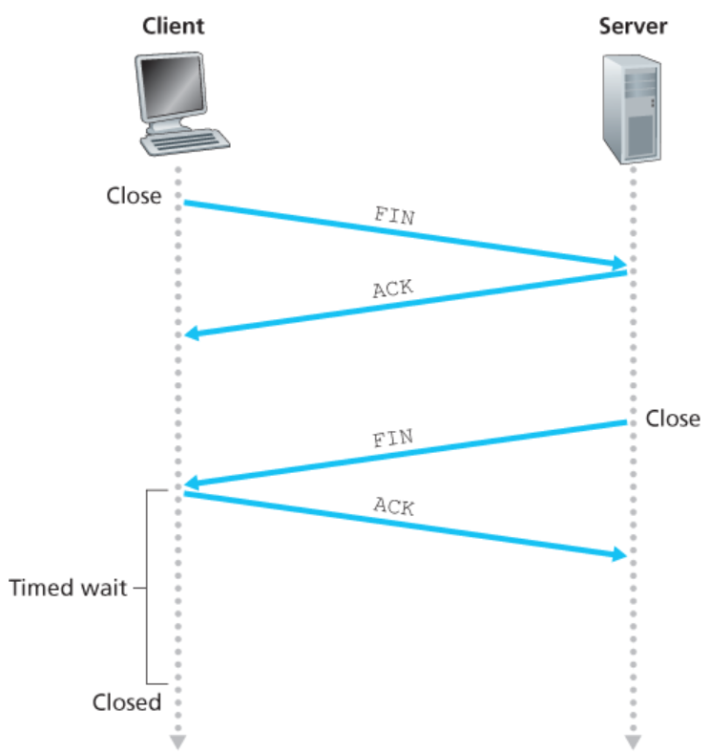
TCP: closing a connection

Slide 61
TCP: closing a connection
clientSocket.close()
can no longer
send but can
receive data
FINbit=1, seq=x
ACKbit=1; ACKnum=x+1
can still
send data
wait for server
close
FINbit=1, seq=y
can no longer
send data
ACKbit=1; ACKnum=y+1
timed wait
for 2*max
segment lifetime

Slide 62
Set 3: summary
principles behind transport layer services:
multiplexing, demultiplexing
reliable data transfer
flow control
congestion control
instantiation, implementation in the Internet
UDP
TCP
next:
leaving the network “edge” (application, transport layers)
into the network “core”
two network layer chapters:
data plane
control plane

